Slide 1
Making Causal Claims as a Data Scientist: Tips and Tricks Using R
Lucy D’Agostino McGowan

Slide 2
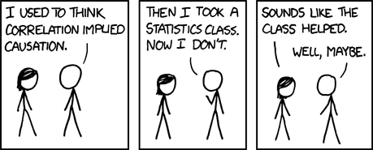
https://xkcd.com/552/

Slide 3
https://xkcd.com/552/

Slide 4
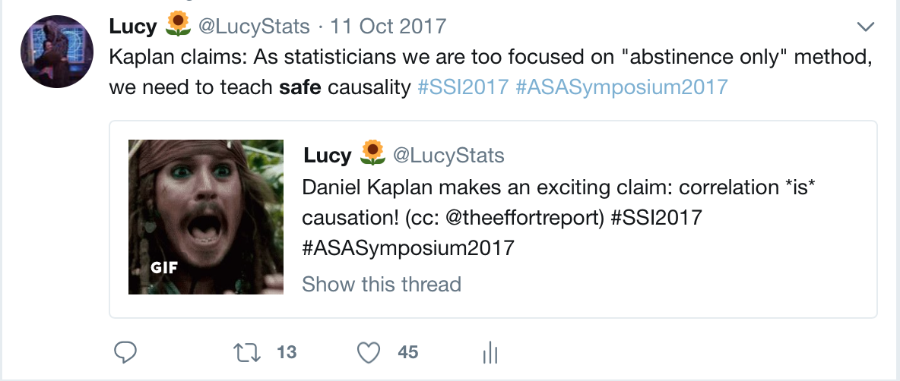
Notes:
Daniel Kaplan, a professor in Mathematics & Computer Science, Macalester College

Slide 5
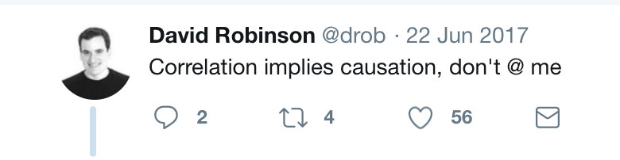

Slide 6
✌️ parts
Discuss some ways to strengthen a causal argument: Hill’s criteria
Discuss a specific causal inference method: propensity scores + sensitivity analyses

Slide 7
Hill’s Criteria
https://commons.wikimedia.org/wiki/File:Austin_Bradford_Hill.jpg
Notes:
Sir Austin Bradford Hill, a statistician and epidemiologist, created a list of guidelines for evaluating whether there is evidence of a causal relationship.[1] He determined the following aspects of associations ought to be considered when assessing causality.

Slide 8
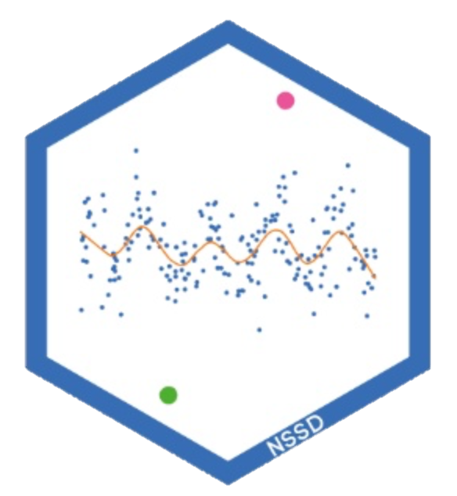
http://nssdeviations.com
http://livefreeordichotomize.com/2016/12/15/hill-for-the-data-scientist-an-xkcd-story/
Notes:
Hilary Parker&Roger Peng’s Not So Standard Deviations Episode 28

Slide 9
https://xkcd.com/539/
Strength
Notes:
How big is the effect you are seeing?
Note: Hill suggests that huge effects can suggest causality, however this does not mean small effects cannot

Slide 10
Consistency
https://xkcd.com/242/
Notes:
This is essentially reproducibility &replicability
Can your analysis be reproduced?
Has anyone been able to replicate your findings?

Slide 11
Specificity
https://xkcd.com/1217/
Notes:
Can the association be pinpointed to a specific cause with no other plausible explanation?
I appreciate Hill’s caveat here, “if specificity exists we may be able to draw conclusions without hesitation; if it is not apparent, we are not thereby necessarily left sitting irresolutely on the fence.”

Slide 12
Temporality
https://xkcd.com/925/
Notes:
Does the timeline make sense?
In general, the exposure ought to come before the outcome it is said to cause.

Slide 13
Biological
gradient
https://xkcd.com/323/
Notes:
The wording of this point makes it a bit difficult to untangle from the medical application, but generally this refers to a dose effect
Does increasing an exposure yield a change in the outcome.

Slide 14
Plausibility
https://xkcd.com/605/

Slide 15
https://xkcd.com/1170/
Coherence
Notes:
Similar to plausibility, is there a logical argument that can be made by/to experts in the field regarding causality.
Does it fit into the understanding of the field (authors note: this should have caveats too…the field could be wrong).

Slide 16
Analogy
https://xkcd.com/882/
Notes:
Have we seen a similar effect from a similar exposure?

Slide 17
Experiment
https://xkcd.com/1462/

Slide 18
What if you can’t do a controlled experiment?

Slide 19

Observational Studies
Goal: Answer a research question
exposure
outcome

Slide 20
Observational Studies
“Gold Standard” – Randomized Controlled Trials
Treatment
P=0.5
Control
P=0.5

Slide 21
Observational Studies
“Gold Standard” – Randomized Controlled Trials
A
P=0.5
B
P=0.5

Slide 22
Observational Studies
Treatment
P=0.9
Control
P=0.1

Slide 23
Observational Studies
Exposed
P=0.8
Unexposed
P=0.2

Slide 24
Observational Studies
Exposed
P=0.8
Unexposed
P=0.2

Slide 25
Observational Studies
Exposed
P=0.9
Unexposed
P=0.1

Slide 26


Slide 28
Confounding
Confounder
Exposure
Outcome

Slide 29
Confounding
Confounder
Exposure
Outcome

Slide 30
Meaningful confounders
1. How imbalanced is the unmeasured confounder between the exposure groups?
2. How predictive is the unmeasured confounder of the outcome?

Slide 31
Confounding
Confounder
Exposure
Outcome

Slide 32
Meaningful confounders
1. How imbalanced is the unmeasured confounder between the exposure groups?
2. How predictive is the unmeasured confounder of the outcome?

Slide 33
Confounding
Confounder
Exposure
Outcome

Slide 35
Propensity scores
Rosenbaum and Rubin showed in observational studies, conditioning on propensity scores can lead to unbiased estimates of the treatment effect
There are no unmeasured confounders
Every subject has a nonzero probability of receiving either treatment

Slide 36
Propensity scores
Rosenbaum and Rubin showed in observational studies, conditioning on propensity scores can lead to unbiased estimates of the treatment effect
There are no unmeasured confounders
Every subject has a nonzero probability of receiving either treatment

Slide 37

Propensity scores
Fit a logistic regression predicting treatment using known covariates
$$Pr\left(treatment=1\right)=\frac{1}{1+exp\left(−Xβ\right)}$$
Each individuals' predicted values are the propensity scores

Slide 38
Propensity scores
glm(exposure ~ smoker + cowboy_hat + sick . . .,
data = df,
family = binomial)

Slide 39
Propensity scores
glm(exposure ~ smoker + cowboy_hat + sick . . .,
data = df,
family = binomial) %>%
predict()

Slide 40
Propensity scores
glm(exposure ~ smoker + cowboy_hat + sick . . .,
data = df,
family = binomial) %>%
predict()
#> 1 2 3 4 5 #> 0.831823 0.562374 0.942197 2.288641 0.366256

Slide 41
Propensity scores
glm(exposure ~ smoker + cowboy_hat + sick . . .,
data = df,
family = binomial) %>%
predict(type = “response”)

Slide 42
Propensity scores
glm(exposure ~ smoker + cowboy_hat + sick . . .,
data = df,
family = binomial) %>%
predict(type = “response”)
#> 1 2 3 4 5 #> 0.6967404 0.6370019 0.7195434 0.9079320 0.5905542

Slide 43
Propensity scores
p <- glm(exposure ~ smoker + cowboy_hat + sick . . .,
data = df,
family = binomial) %>%
predict(type = “response”)

Slide 44
Propensity scores
0.9
0.2
0.1
0.3
0.7
0.3
0.1
0.6
0.6
0.9
0.2
0.2
0.3
0.1
0.1
0.8
0.7
0.7
0.8
0.2
0.2

Slide 45
Propensity scores
0.9
0.2
0.1
0.3
0.6
0.6
0.9
0.2
0.3
0.1
0.8
0.7
0.7
0.8
0.2
0.2

Slide 46
Propensity scores
0.2
0.2
0.3
0.6
0.7
0.8
0.9
0.1
0.1
0.2
0.2
0.3
0.6
0.7
0.8
0.9

Slide 47
Propensity Scores
Weighting
Matching
Stratification
Direct Adjustment
…

Slide 48
Propensity Scores
Weighting
Matching
Stratification
Direct Adjustment
…

Slide 49

Weighting
$$w_{ATM}=\frac{\min{\{p_{i}, 1−p_{i}\}}}{Z_{i}p_{i}+(1−Z_{i})(1−p_{i})}$$

Slide 50
Weighting
p_0 <- 1 - p
df$weight <- pmin(p, p_0) /
ifelse(exposure == 1, p, p_0)

Slide 51
Imbalance between exposures
0.2
0.2
0.3
0.6
0.7
0.8
0.9
0.1
0.1
0.2
0.2
0.3
0.6
0.7
0.8
0.9

Slide 52
Imbalance between exposures
0.2
0.2
0.3
0.6
0.7
0.8
0.9
0.1
0.1
0.2
0.2
0.3
0.6
0.7
0.8
0.9

Slide 53
Propensity Scores
Imbalance between exposures
0.2
0.2
0.3
0.6
0.7
0.8
0.9
0.1
0.1
0.2
0.2
0.3
0.6
0.7
0.8
0.9

Slide 54
Propensity scores
0.1
0.2
0.2
0.3
0.6
0.7
0.8
0.9
0.1
0.2
0.2
0.3
0.6
0.7
0.8
0.9
0.1
0.2
0.2
0.3
0.6
0.7
0.8
0.9
0.1
0.2
0.2
0.3
0.6
0.7
0.8
0.9
0.1
0.2
0.2
0.3
0.6
0.7
0.8
0.9
0.1
0.2
0.2
0.3
0.6
0.7
0.8
0.9
0.1
0.2
0.2
0.3
0.6
0.7
0.8
0.9
0.1
0.2
0.2
0.3
0.6
0.7
0.8
0.9

Slide 55
0.1
0.2
0.2
0.3
0.6
0.7
0.8
0.9
0.1
0.2
0.2
0.3
0.6
0.7
0.8
0.9
0.1
0.2
0.2
0.3
0.6
0.7
0.8
0.9
0.1
0.2
0.2
0.3
0.6
0.7
0.8
0.9
0.1
0.2
0.2
0.3
0.6
0.7
0.8
0.9
0.1
0.2
0.2
0.3
0.6
0.7
0.8
0.9
0.1
0.2
0.2
0.3
0.6
0.7
0.8
0.9
0.1
0.2
0.2
0.3
0.6
0.7
0.8
0.9
0.1
0.2
0.2
0.3
0.6
0.7
0.8
0.9
0.1
0.2
0.2
0.3
0.6
0.7
0.8
0.9
0.1
0.2
0.2
0.3
0.6
0.7
0.8
0.9
0.1
0.2
0.2
0.3
0.6
0.7
0.8
0.9
0.1
0.2
0.2
0.3
0.6
0.7
0.8
0.9
0.1
0.2
0.2
0.3
0.6
0.7
0.8
0.9
0.1
0.2
0.2
0.3
0.6
0.7
0.8
0.9
0.1
0.2
0.2
0.3
0.6
0.7
0.8
0.9
0.1
0.2
0.2
0.3
0.6
0.7
0.8
0.9
0.1
0.2
0.2
0.3
0.6
0.7
0.8
0.9
0.1
0.2
0.2
0.3
0.6
0.7
0.8
0.9
0.1
0.2
0.2
0.3
0.6
0.7
0.1
0.2
0.2
0.3
0.6
0.7
0.8
0.9
0.1
0.2
0.2
0.3
0.6
0.7
0.8
0.9
0.1
0.2
0.2
0.3
0.6
0.7
0.8
0.9

Slide 56
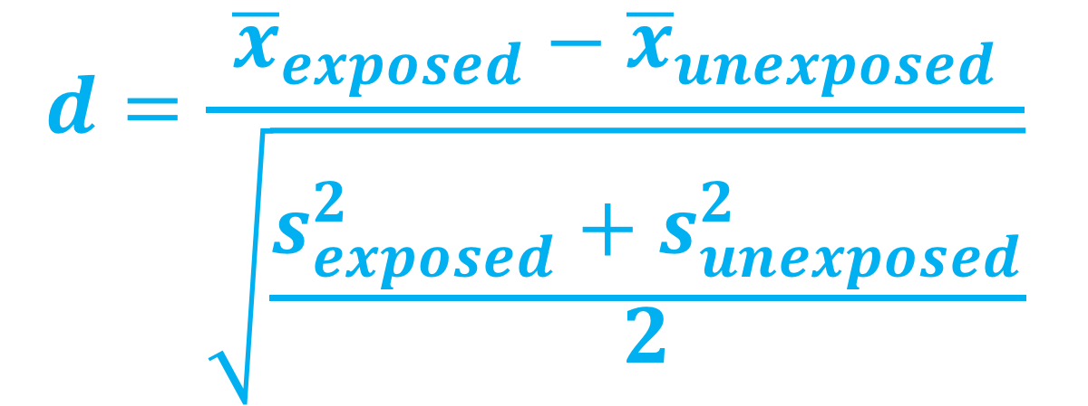
Standardized mean difference
$$d=\frac{{\overline{x}}_{exposed}−{\overline{x}}_{unexposed}}{\sqrt{\frac{s_{exposed}^{2}+s_{unexposed}^{2}}{2}}}$$

Slide 57
Standardized Mean Difference
library(survey)
svy_des <- svydesign(
ids = ~ 1,
data = df,
weights = ~ weight)

Slide 58
Standardized Mean Difference
library(tableone)
smd_table <- svyCreateTableOne(
vars = c(“smoker”, “cowboy_hat”, “sick”, . . .),
strata = “exposure”,
data = svy_des)
print(smd_table, smd = TRUE)

Slide 59
Love plots
$$d=\frac{{\overline{x}}_{exposed}−{\overline{x}}_{unexposed}}{\sqrt{\frac{s_{exposed}^{2}+s_{unexposed}^{2}}{2}}}$$

Slide 60
Imbalance between exposures
Love Plots

Slide 61
Propensity scores

Slide 62
Imbalance between exposures
Love Plots

Slide 63
Imbalance between exposures
0.2
0.2
0.3
0.6
0.7
0.8
0.9
0.1
0.1
0.2
0.2
0.3
0.6
0.7
0.8
0.9

Slide 64
Imbalance between exposures
Love Plots

Slide 65
unmeasured confounding

Slide 66
All you need
Exposure-outcome effect
Exposure-unmeasured confounder effect
Outcome-unmeasured confounder effect

Slide 67
All you need
Exposure-outcome effect generally estimated from a model, for example an odds ratio, hazard ratio, or risk ratio
Exposure-unmeasured confounder effect
Outcome-unmeasured confounder effect

Slide 68
All you need
Exposure-outcome effect generally estimated from a model, for example an odds ratio, hazard ratio, or risk ratio
Exposure-unmeasured confounder effect
Outcome-unmeasured confounder effect

Slide 69
All you need
Exposure-outcome effect generally estimated from a model, for example an odds ratio, hazard ratio, or risk ratio
Exposure-unmeasured confounder effect
Outcome-unmeasured confounder effect

Slide 70
All you need
Exposure-outcome effect generally estimated from a model, for example an odds ratio, hazard ratio, or risk ratio
Exposure-unmeasured confounder effect
Outcome-unmeasured confounder effect

Slide 71

Tipping point analyses
what will tip our confidence bound to cross 1

Slide 72
1.5
Observed bias plot

Slide 73


Imbalance between exposures
$p_{0}=0.1$
$$p_{1}=0.3$$
Love Plots

Slide 74
“
A hypothetical unobserved binary confounder that is prevalent in 30% of the exposed population and 10% of the unexposed population would need to have an association with Y of 4.33 to tip this analysis at the 5% level, rendering it inconclusive.
”

Slide 75

$$Γ=3.5$$
Observed bias plot

Slide 76
conclusion
we have presented a useful, easily implemented, and intuitively understood approach to allow researchers to assess the potential impact of unmeasured confounders in observational research
can be applied to both past and future research, allowing readers to understand the sensitivity of studies that do not include such an analysis, and allowing future investigators to readily include such an analysis

Slide 77
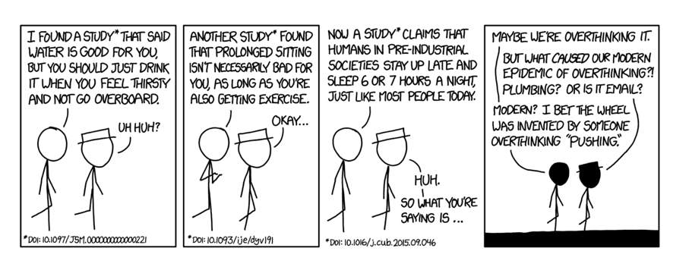
https://xkcd.com/1592
On the other hand, it took us embarrassingly long to clue in to the lung cancer/cigarette thing, so I guess the real lesson is "figuring out which ideas are true is hard."
Data Day Texas 2018

Slide 78
References
Cornfield, J., Haenszel, W., Hammond, E. C., Lilienfeld, A. M., Shimkin, M. B., & Wynder, E. L. (2009). Smoking and lung cancer: recent evidence and a discussion of some questions. 1959. International journal of epidemiology (Vol. 38, pp. 1175–1191). Oxford University Press. http://doi.org/10.1093/ije/dyp289
Schlesselman, J. J. (1978). Assessing effects of confounding variables. American Journal of Epidemiology, 108(1), 3–8.
Rosenbaum, P. R., & Rubin, D. B. (1983). The Central Role of the Propensity Score in Observational Studies for Causal Effects. Biometrika, 70(1), 41. http://doi.org/10.2307/2335942
Lin, D. Y., Psaty, B. M., & Kronmal, R. A. (1998). Assessing the sensitivity of regression results to unmeasured confounders in observational studies. Biometrics, 54(3), 948–963.
VanderWeele, T. J., & Ding, P. (2017). Sensitivity Analysis in Observational Research: Introducing the E-Value. Ann Intern Med, 167(4), 268–274. http://doi.org/10.7326/M16-2607
Data Day Texas 2018

Slide 79


Thank you!
@LucyStats
ld.mcgowan@vanderbilt.edu
lucymcgowan.com

